Slide 1


Price Analysis leveraging BPR concepts and Analytics tools

Slide 2
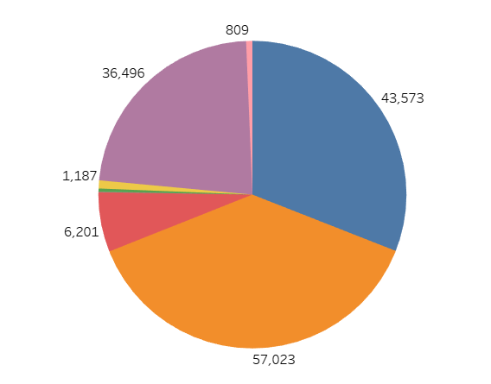
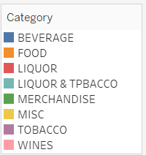
From the above graph we can see the sum of quantity of each category sold in the fiscal year and the colour shade shows the different categories listed the right side below.

Slide 3
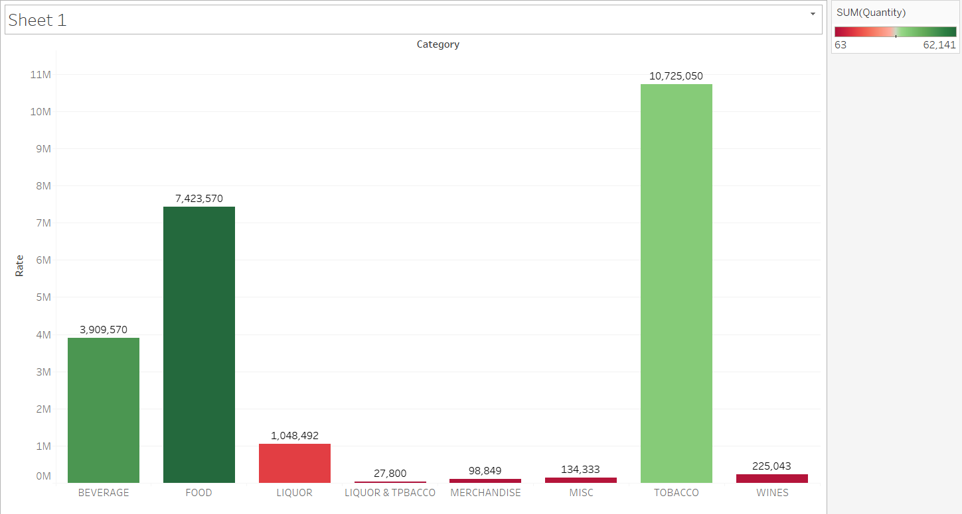
CATEGORY VS RATE
From the graph we can state that the Revenue gained by the Super cafe using the different categories.
The least sales category is LIQUOR & TPBACCO.
The highest sales category is TOBACCO.
TOBACCO, FOOD and BEVERAGE are the three highest sold categories in Super café.

Slide 4
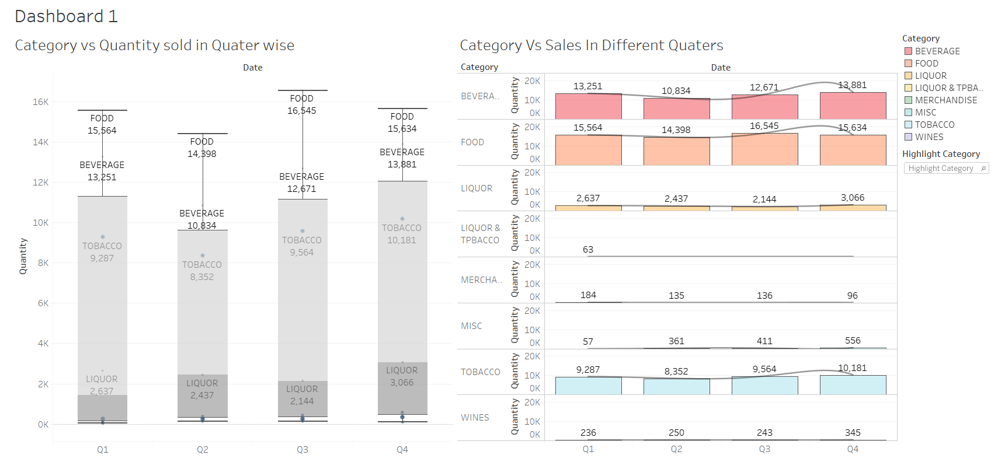
Sum of Quantity for each Date Quarter. Size shows details about Category. The marks are labeled by Category and sum of Quantity. Details are shown for Category.
Sum of Quantity for each Date Quarter broken down by Category. Color shows details about Category. The marks are labeled by sum of Quantity.

Slide 5
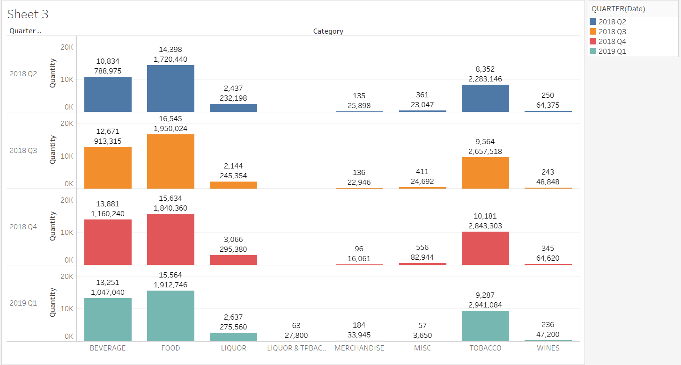
Sum of Quantity for each Category broken down by Date Quarter. Color shows details about Date Quarter. The marks are labeled by sum of Quantity and sum of Rate.

Slide 6
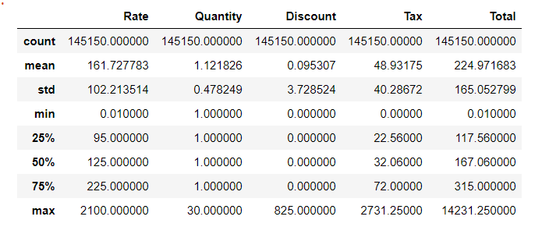
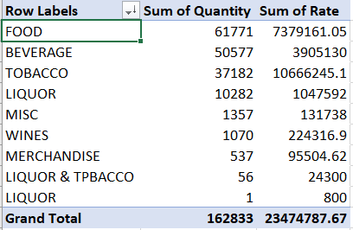
DATA DESCRIBE
The Table shows the small calculations of the data to analyse and understand the spread of the data.
The Tax is directly proportional to the rate of the product.
The quantity doesn’t have an impact on the increase or decrease on the rate.
Even Though The Quantity is sold high in FOOD But the highest Revenue generated from the TOBBACO.

Slide 7
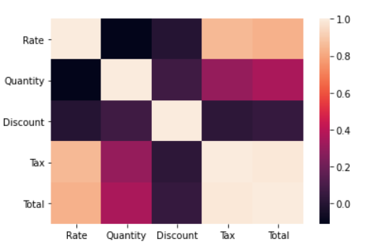
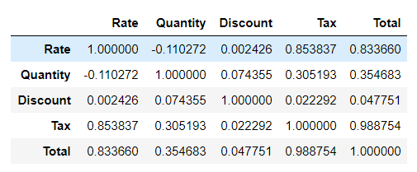
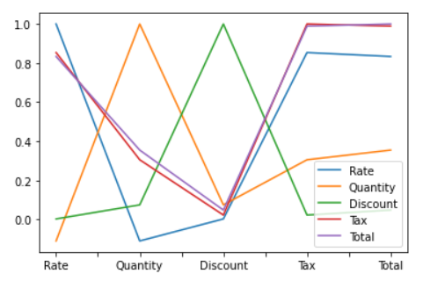
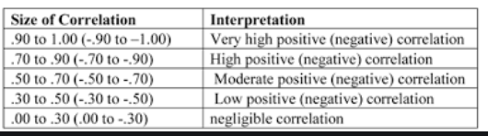
CORRELATAION

Slide 8
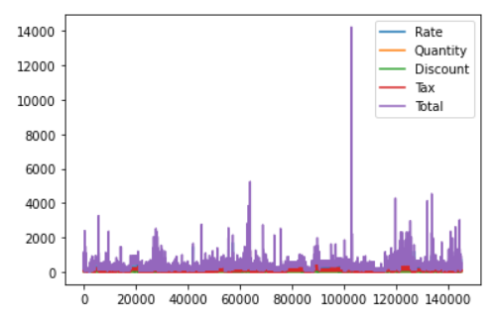
SPECTRUM ANALYSIS USING PYTHON SHOWING COLUMNS AS HUE

Slide 9
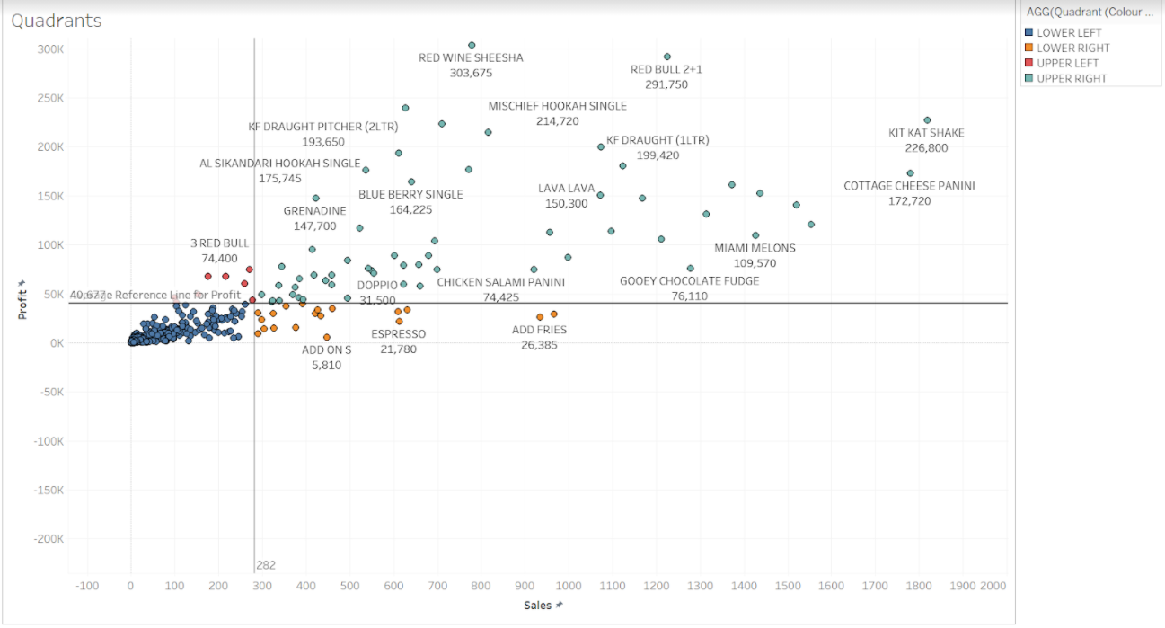
QUARDANT ANALYSIS USING TABLEAU

Slide 10
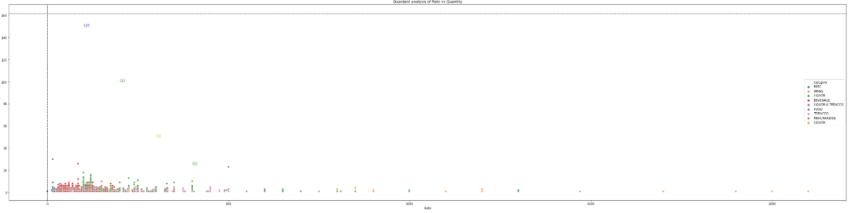
QUARDANT ANALYSIS USING PYTHON

Slide 11
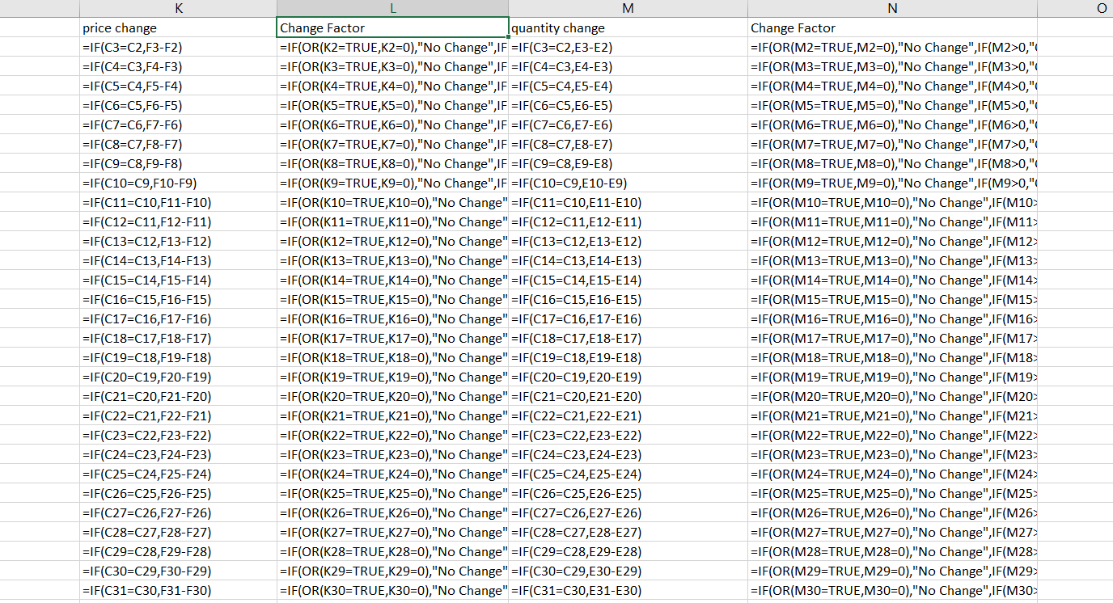
PRICE ANALYSIS
The Result of the Price Analysis is shown in the next PPT

Slide 12
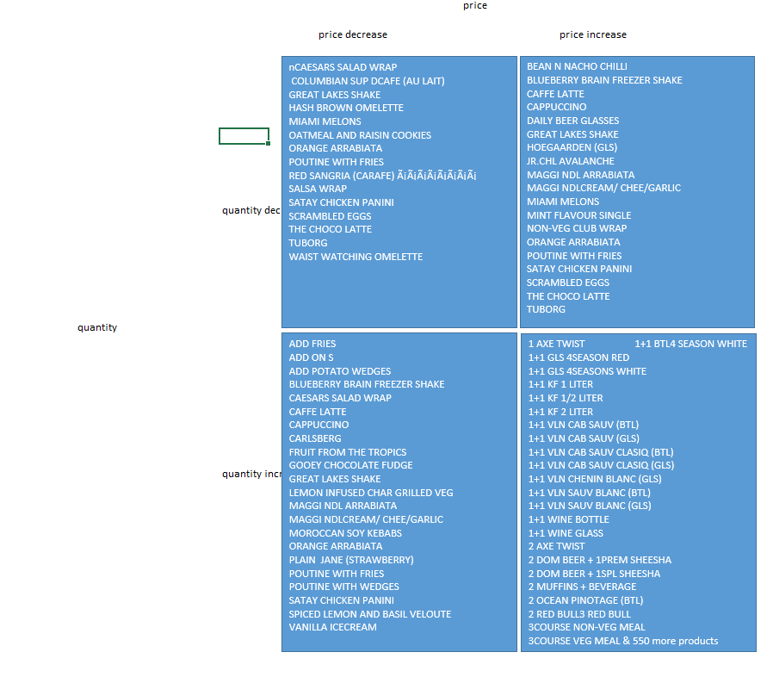
PRICE ANALYSIS
The four quadrants showed in the beside table are shown as below
o Price increased – Sales volume decreased o Price increased – Sales volume increased o Price decreased – Sales volume increased o Price decreased – Sales volume decreased

Slide 13
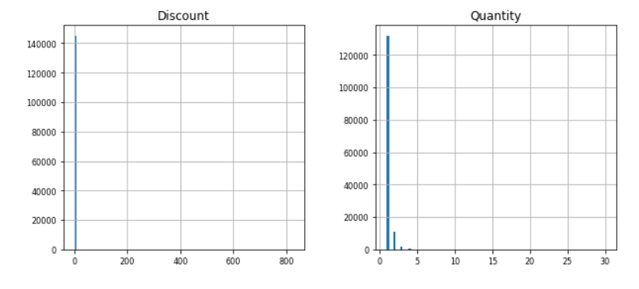
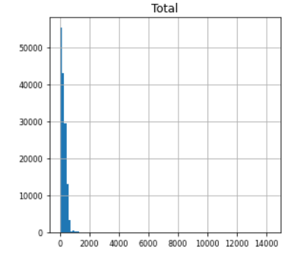
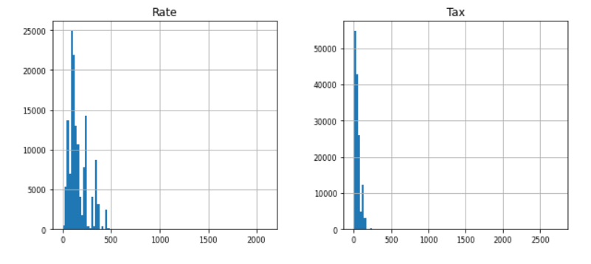
HISTOGRAM ANALYSIS

Slide 14
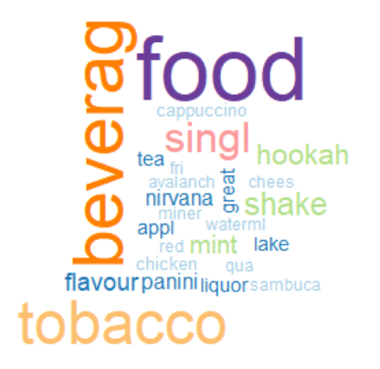
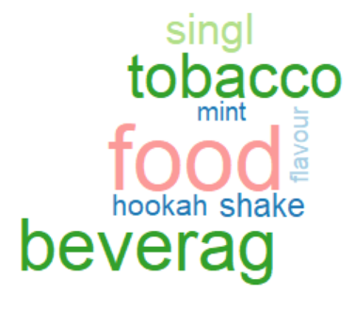
WORDCLOUD

Slide 15
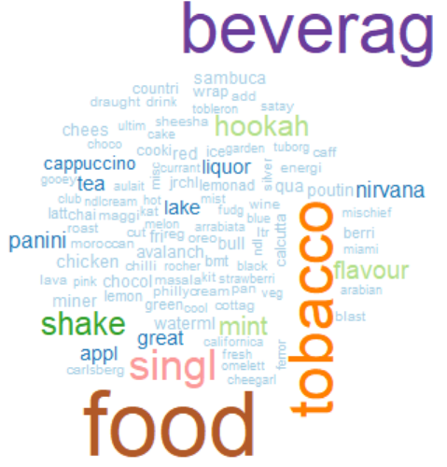



WORDCLOUD
The size of the word in the word cloud indicates most number of times used.
The Top Three Categories sold by the coffee shop is Beverage, Food and Tobacco
TOOLS USED IN THE ANALYSIS

Slide 16



